Slide 1




Climate Uncertainty & Risk
Judith Curry
Georgia Institute
of Technology
Climate Forecast
Applications Network
taichihealth.com

Slide 2

“97% of climate scientists agree"
Surface temperatures have increased since 1880
Humans are adding carbon dioxide to the atmosphere
Carbon dioxide and other greenhouse gases have a warming effect on the planet
Disagreement among scientists:
How much of the warming has been caused by humans
How much the planet will warm in the 21st century
Whether warming is‘dangerous’
How we should respond to the warming, to improve human well being

Slide 3
Why do scientists disagree?
Insufficient & inadequate observational evidence
Disagreement about the value of different classes of evidence (e.g. paleoclimate reconstructions, GCMs)
Disagreement about the appropriate logical framework for linking and assessing the evidence
Assessments of areas of ambiguity & ignorance
Belief polarization as a result of politicization of the science
Uncertainty • Doubt • Ignorance
Notes:
A majority of climate scientists seem to support the IPCC perspective, with recent surveys of scientists suggesting 52-85% of climate scientists agree with the IPCC.

Slide 4

Scientific perils of an explicit consensus building process
Explicit consensus building processes can enforce overconfidence and belief polarization.
Beliefs tend to serve as agents in their own confirmation
Dismissal of skepticism is detrimental to scientific progress
Overreliance on expert judgment motivates shortcuts in reasoning and hidden biases
Narrow framing provides a basis for neglecting research in certain areas
speaking consensus to power

Slide 5

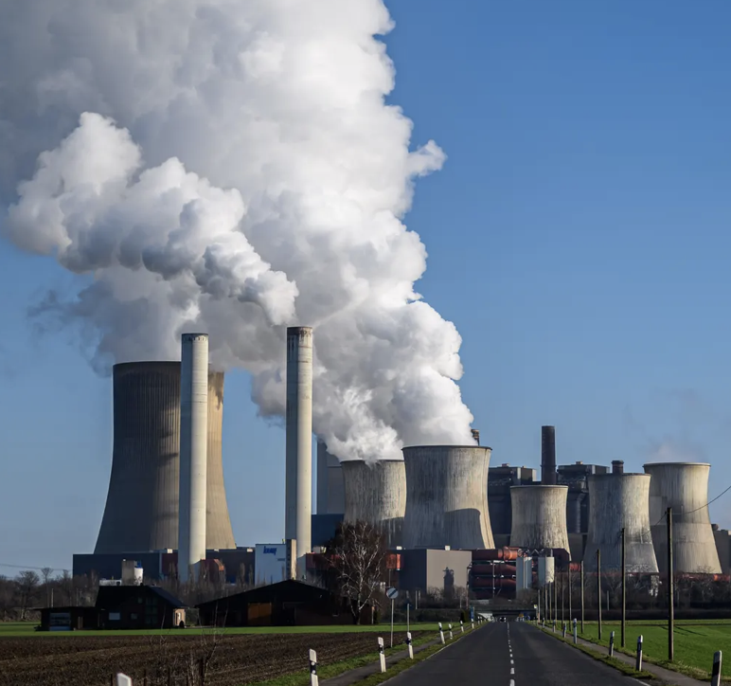
Climate Change – 2 different perspectives
Tame problem
CO₂
X
Goal: controlling the climate
Solution: global

Slide 6
Climate Change – 2 different perspectives
Tame problem
Unknowns – known and unknown
CO₂
Complex, wicked problem
Climate change:
ocean/atm circulations
solar effects
volcanoes
emissions
land use
tidal effects
We can’t control the climate
X
Reduce vulnerability
Solutions:
abundant clean energy
manage water resources
food productivity
Economic development
Goal: controlling the climate
Solution: global
Goal: understanding the climate
Solutions: regional

Slide 7
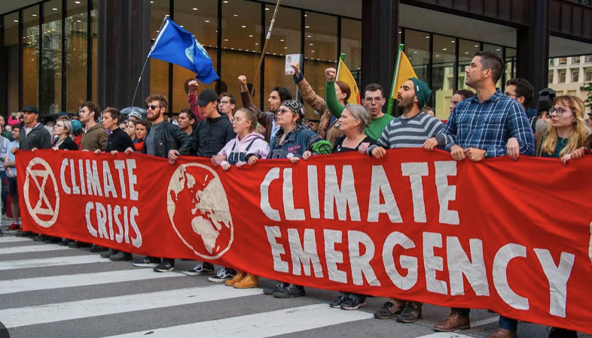
The climate ‘crisis’ isn’t what it used to be
Signals from the UNFCCC and IPCC:
Emissions scenario RCP8.5 is implausible
As 2ºC warming target is in reach, target is reduced to 1.5ºC
IPCC AR6 lowered the upper likely bound of ECS to 4ºC
IPCC AR6: many climate models are running too hot
COP27: expected warming of 2.5ºC by 2100. This is still too high:
Neglect lower and more realistic values of climate sensitivity (Nic Lewis)
Natural factors are skewed cooler during the remainder of the 21st century:
Baseline volcanic activity since 1850 has been unusually low
Possible solar minimum in the 21st century; solar indirect effects neglected
Shift to cold phase of Atlantic Multidecadal Oscillation expected in next decade
Temperature change by 2100 could easily be below 2ºC and even 1.5ºC – note that 1.1ºC warming has already occurred.

Slide 8
“Warming is less than we expected, but the impacts are worse”
“climate risk” is conflation of
incremental risk
emergency risk
Logical fallacy: conflation
Treating two different
concepts as one
sea level rise
water shortages
potential for tipping points
severe weather events
interannual climate variability
Management: vulnerability reduction,
economic development; regional
Management: minimize emissions??;
global
Urgency of addressing emergency risk is used to
motivate the urgency of reducing emissions
Energy poverty from reducing emissions increases emergency risk

Slide 9

Perceptions of Risk
In each pair, 1st risk type is preferred to 2nd:
natural versus manmade risks
risks that are detectable versus undetectable
controllable versus uncontrollable risks
voluntary versus imposed risks
risks with benefits versus uncompensated risks
known risks versus vague risks
everyday risks versus uncommon risks
future versus immediate risks
equitable versus asymmetric distribution of risks.
Climate communications emphasize:
manmade aspects
unfair burden on the poor
extreme weather events
uncontrollable tipping points

Slide 10
We have mischaracterized climate risk
“The current thinking and approaches have been shown to lack scientific rigour, the consequence being that climate change risk and uncertainties are poorly presented. The climate change field needs to strengthen its risk science basis, to improve the current situation.”
- risk scientist Terje Aven
“The global climate change debate has gone badly wrong. Many mainstream
environmentalists are arguing for the wrong actions and for the wrong reasons, and so long as they continue to do so they put all our futures in jeopardy.”
– philosopher Thomas Wells

Slide 11
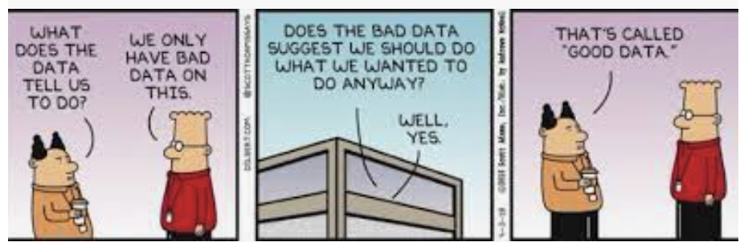
Problems with mixing politics and science
"What you get when mix politics with science is . . . just politics, unfortunately.”
Policy makers misuse science by:
Using science as a vehicle to avoid 'hot potato' policy issues
expecting black-and-white answers to complex problems
demanding scientific arguments for desired policies
funding a narrow range of projects that supports preferred policies.
Scientists misuse policy-relevant science by:
playing power politics with their expertise
conflating evidence with expert judgment
ignoring data and research paths that undermine their political preference
entangling disputed facts with values
intimidating scientists whose research interferes with their political agendas

Slide 12
Wicked science
avoid politicizing
science
avoid scientizing
politics
S
Science
Politics
Wicked
Science
Transdisciplinary: science, technology, humanities, social sciences
Uncertainty is paramount
Problem framing influenced by stakeholders
Control is limited
The future is unknown
Range of policy options
Dissent/disagreement about policy options
Involvement of broad range of stakeholders
Complexity science
Systems thinking
Scientific experts + stakeholders
dual scientific & political natures of wicked societal problems

Slide 13
science
technology
politics
policy
philosophy
social psych
uncertainty
risk
Navigating the wickedness
of climate change
Rethinking the climate change problem, the risks we are facing, and
how we can respond.
Judith Curry, Climate Uncertainty and Risk,
Anthem Press, 256 pp (in press)

Slide 14
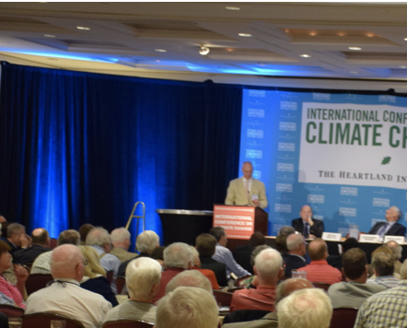
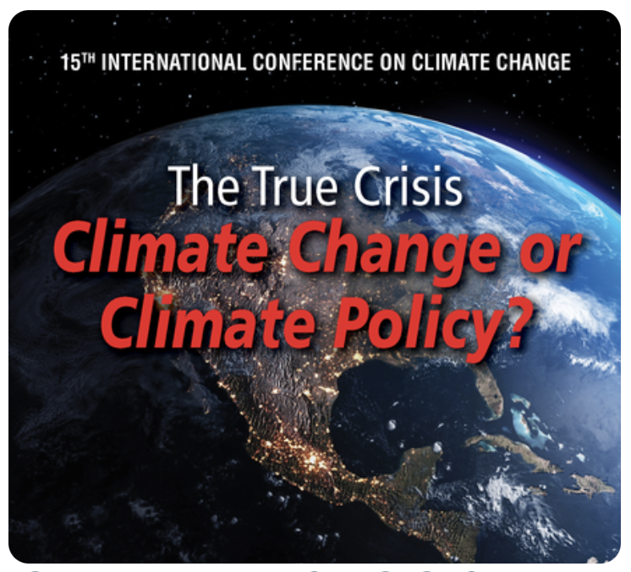

The ICCC: Wicked Science in Action

Slide 15



http://judithcurry.com
@curryja
Thank you
Judith Curry
curry.judith@gmail.com

