Slide 1
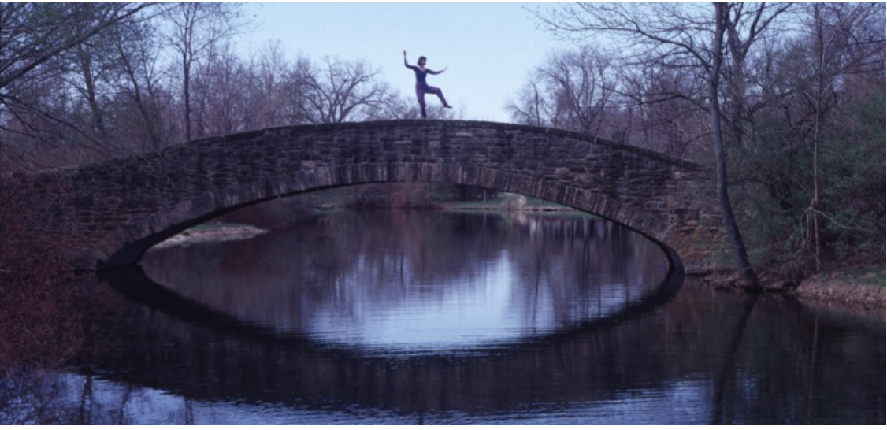


Reflections on Taiji and Science
Judith Curry
Georgia Institute
of Technology
Climate Forecast
Applications Network
taichihealth.com

Slide 2

About me
Professional interests:
Climate science
Uncertainty & risk sciences
Philosophy of science
Personal interest:
Health sciences
UC Santa Barbara

Slide 3
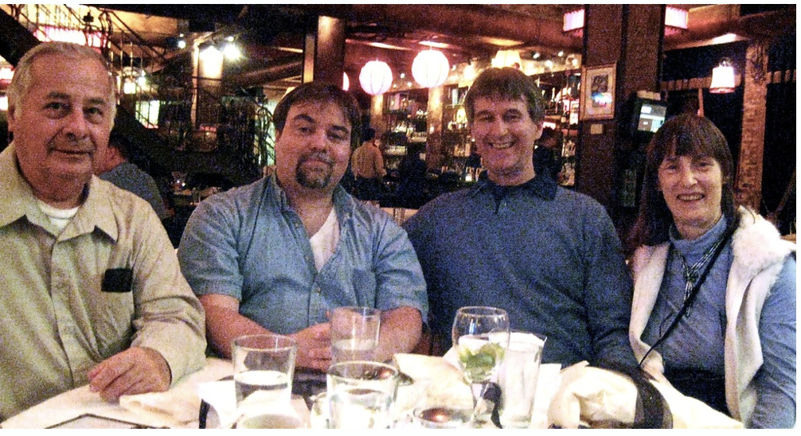
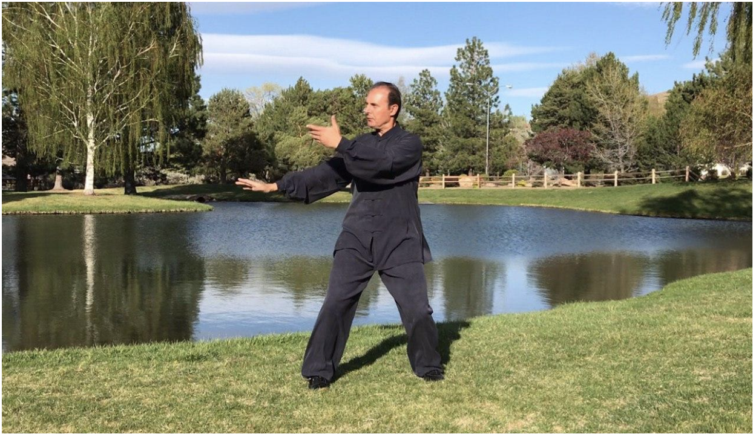
My heritage in Taiji
University of Chicago Tai Chi Club 1980s
Caughlin Club Reno NV current
Sifu Bruce
Moran
Sifu Ed
Gierut
Sifu Bruce Moran
Yang Old Style
Tai Chi Ch’uan, Qigong, Tui na
Tai Chi Tao Paragon Principles
Master Reza Nejad
Tai Chi and Qigong

Slide 4

Practice
Science
Philosophy
duality of yin-yang
towards transformational research

Slide 5
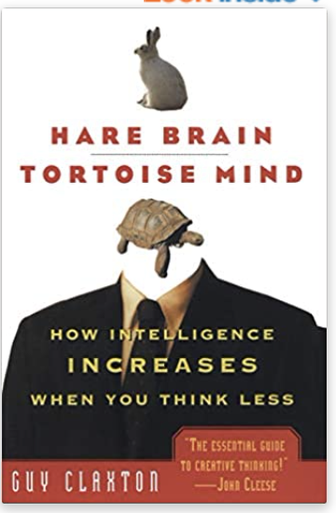
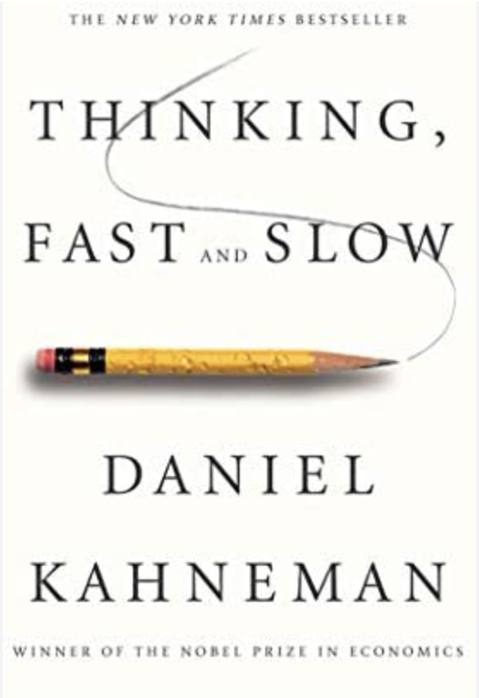
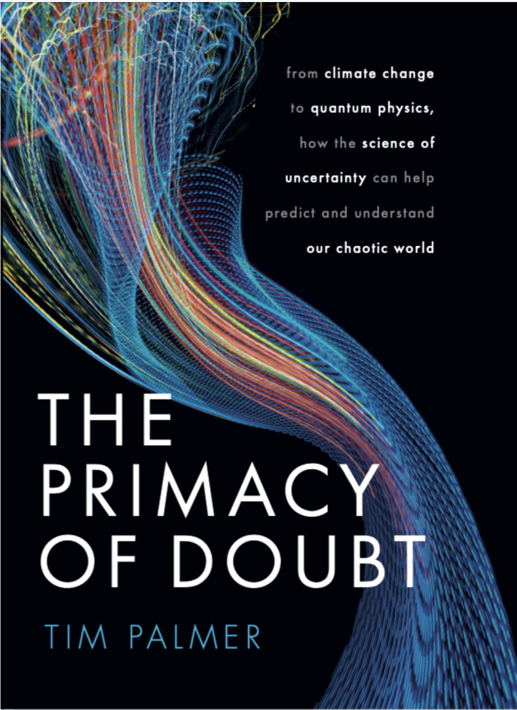
Binary modes of thinking
System 1: (yang)
fast, automatic, multitasking
System 2: (yin)
deliberate, mindful intent
“the leisurely tortoise mind, for all its apparent aimlessness, is just as intelligent as the more logical hare brain.” - Claxton
economics
physics
#1 thinking fast
#2 thinking slow
#1 stochasticity
#2 determinism
#2 hare brain
#1 tortoise mind
psychology

Slide 6

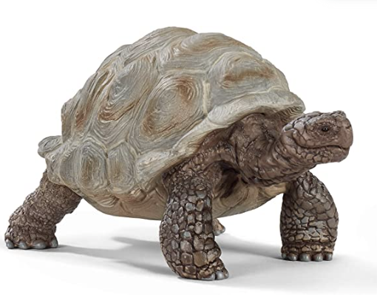
Role of the monkey in creativity
In low power mode (System 1) when the brain is multi-tasking, the operation of any one of the active neurons is susceptible to noise.
To generate random new ideas, the brain must be susceptible to noise. Eureka moments occur when relaxing and not concentrating on a problem.
Oneness: the idea is to make constructive use of noise in low-power mode to provide new perspectives which our more analytic, power-intensive mode is failing to give us.
Tim Palmer, The Primacy of Doubt

Slide 7
Yin
Yang
SCIENCE
Order
Reductionism
Causal thinking
Disciplinary
Foundational knowledge
Chaos
System complexity
Circularity & feedbacks
Transdisciplinary
Knowledge frontiers
Transformative research

Slide 8

Frames
Complex problem
Frames: organizing principles that shape how people conceptualize an issue.
Frames direct how a problem is stated, what is excluded, what is relevant, and what answers are appropriate.
Framing bias: narrow approach pre-ordains the conclusion to a much more complex problem.
Tame problem
uncertainty
complexity
ambiguity
chaos
many perspectives
contradictions
reductionism
order
control
acknowledgement of what is outside the frame and its potential importance

Slide 9
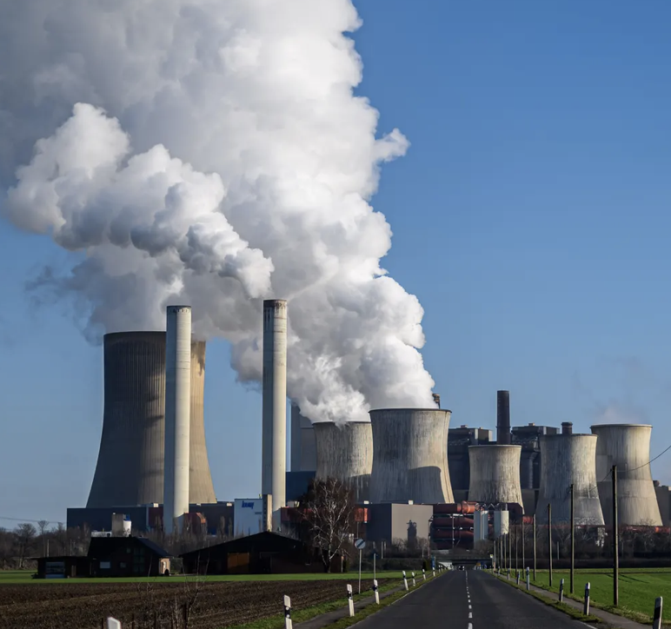
Climate Change
Yin - order
Yang - chaos
control
Unknowns – known and unknown
CO₂
Climate change:
ocean/atm circulations
solar effects
volcanoes
emissions
land use
tidal effects
We can’t control the climate
X
Reduce vulnerability
Solutions:
abundant clean energy
manage water resources
food productivity
Economic development
Goal: controlling the climate
Goal: understanding the climate

Slide 10

Covid-19 pandemic
Normal science (yin)
Follow the ‘science’
Post-normal science (yang)
“where facts are uncertain, values in dispute, stakes high & decisions urgent.” – Funtowicz & Ravetz
viral structures & pathogenic mechanisms
development of vaccines
antiviral drugs
Early in the pandemic:
2-3/100 infected will die
Spread by droplets & surfaces
No immunity after infection
All ages equally at risk
evaluating knowledge quality is paramount
management of uncertainty
complexity is respected
diversify knowledge base
extended peer community
consensus enforcement
attempt to control
manage, not control
seek robustness in policy strategy

Slide 11
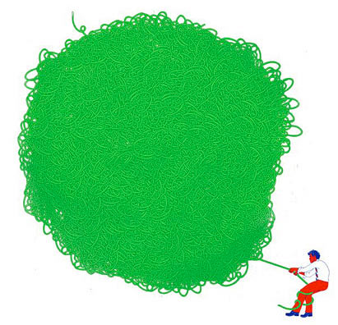
Wicked problems and their solutions
Structural complexity
Uncertainty, chronic ignorance
Multiple problem definitions
Contentious methods of understanding
Clashing values
Lack of capacity to imagine future eventualities of both the problem and its solutions
Difficult to identify points of failure/ success in the science or policies.

Slide 12
Wicked science
avoid politicizing
science
avoid scientizing
politics
S
Science
Politics
Wicked
Science
Transdisciplinary: science, technology, humanities, social sciences
Uncertainty is paramount
Problem framing influenced by stakeholders
Control is limited
The future is unknown
Range of policy options
Dissent/disagreement about policy options
Involvement of broad range of stakeholders
Complexity science
Systems thinking
Scientific experts + stakeholders
dual scientific & political natures of wicked societal problems

Slide 13
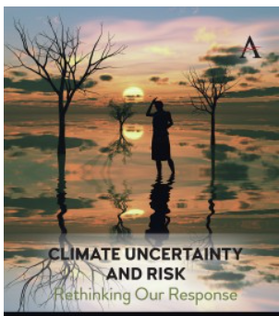

Navigating the wickedness of climate change
science
technology
politics
policy
philosophy
social psych
uncertainty
risk
yin
productive mode
Order
Winnow
Refine
Synthesize
Write
Verify
Expand horizons
Generate ideas
Create links
Google search
Judith Curry
yang
Judith Curry, Climate Uncertainty and Risk,
Anthem Press, 256 pp (in press)
creative mode

Slide 14

Taiji health science
east – west
basic science – clinical science
Regulation networks – whole body
Precision medicine – reductionism
curative – preventive
science – practice
transformative research without boundaries

Slide 15



http://judithcurry.com
@curryja
Thank you
Judith Curry
curry.judith@gmail.com

