Slide 1
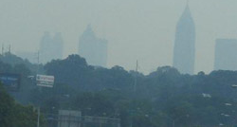
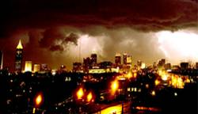
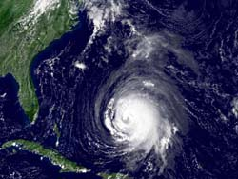
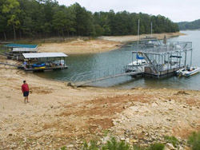
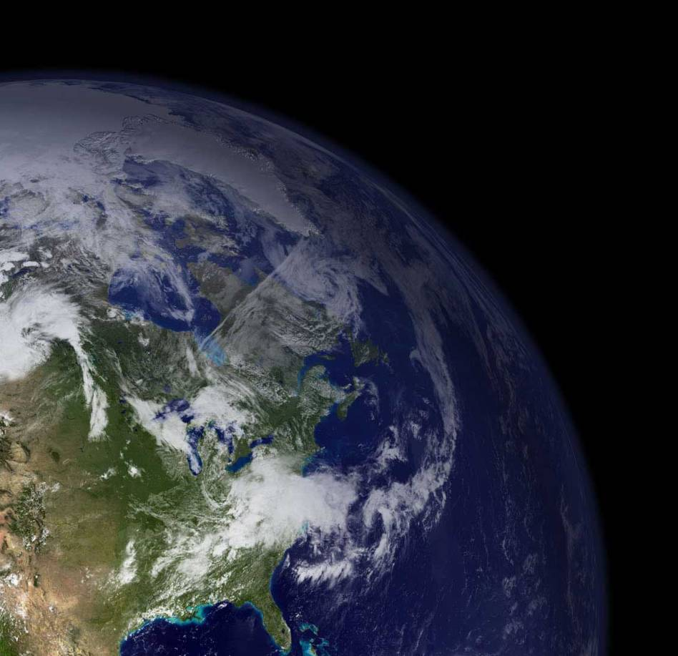
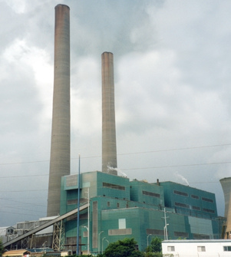
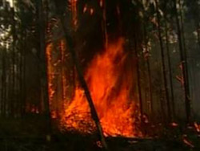


Climate Change Science
Fact, Fiction & the Unsettled
Judith Curry
Notes:
Thank you Teresa for the kind introduction. And I would like to thank the SPE for sponsoring this event.
The title of my talk is Climate Change Science: Fact, Fiction & the Unsettled

Slide 2
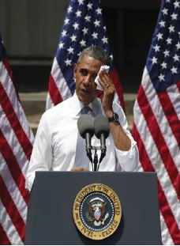
President Obama on
Climate Change
The U.S. is leading global efforts to address the threat of climate change.
www.whitehouse.gov/climate-change
“For all the challenges we face, the growing threat of climate change could define the contours of this century more dramatically than any other.”
”The United States of America not only recognizes our role in creating this problem, we embrace our responsibility to do something about it."
Notes:
President Obama has made climate change one of the centerpieces of his second term as president. Featured prominently on his website: READ.
Here are some quotes from his speech in Paris last December READ

Slide 3



UNFCCC Treaty (1992):
The UNFCCC established a goal of stabilization of atmospheric greenhouse gases to prevent dangerous climate change
Intergovernmental Panel on Climate Change (IPCC):
Human-caused climate change is real
Human-caused climate change is dangerous
Action is needed to prevent dangerous human caused climate change
Notes:
The recent political and scientific history of climate change has been driven by the United Nations Framework Convention on Climate Change. The 1992 Treaty established . . . For the past 25 years, the Intergovernmental Panel on Climate Change, or the IPCC, has been conducting comprehensive assessments, that have successively increased in confidence that . . . .

Slide 4

Paris Climate Agreement
Reaffirm the goal of limiting global temperature increase well below 2ºC, while urging efforts to limit the increase to 1.5º
Establish binding commitments by all parties to make “nationally determined contributions” (NDCs), and to pursue domestic measures aimed at achieving them
Commit all countries to submit new NDCs every five years, with the clear expectation that they will represent a progression beyond previous ones
xxxxxxxxxxx
Notes:
Last December, the UN Framework Convention met in Paris and established an International Climate Agreement. Here are the main tenets of the agreement:
Last month, 175 countries signed the agreement, including the U.S., and the agreement is expected to be implemented in 2017.

Slide 5
Nationally Determined Contributions (NDCs)
U.S. NDC:
Reduce emissions by 26-28% below 2005 levels by 2025
Economy-wide emission reductions of 80% by 2050
Notes:
Under the Paris agreement, the UN Framework Convention on Climate Change is seeking to limit emissions of carbon dioxide and other greenhouse gases through voluntary National Determined Contributions, or NDCs. The key elements of the U.S. NDC are READ
Most of the near term efforts are centered around the Clean Power Plan, which is seeking to drastically reduce the use of fossil fuels in the generation of electricity.

Slide 6

The ‘treaty’ problem
U.S. Constitution Treaty Clause:
“ [The President] shall have Power, by and with the Advice and Consent of the Senate, to make Treaties, provided two thirds of the Senators present concur . . . “
Sense of the Senate Resolution: 1/20/15
“Climate change is real and not a hoax” (98-1)
“Climate change is real; and human activity significantly contributes to climate change.” (50-49)
Notes:
The Paris agreement is not a treaty, and therefore not binding. The main reason that the UN Framework Convention did not seek a new treaty is because of the Treaty Clause in the US Constitution: READ
What the Senate thinks about climate change was clarified last January by the Sense of the Senate Resolution.

Slide 7
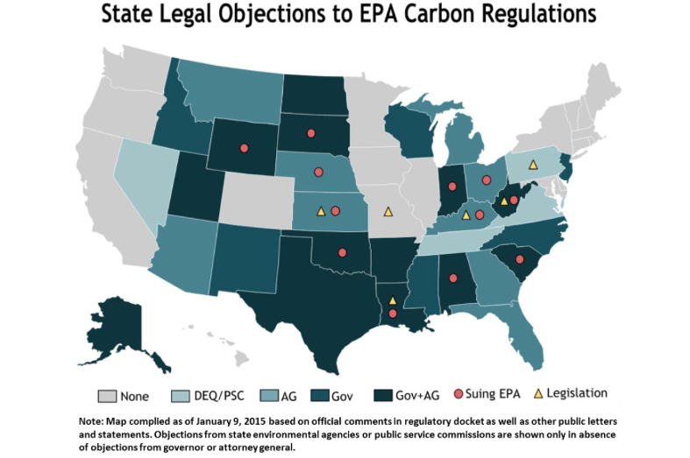
http://assets.inhabitat.com/wp-content/blogs.dir/1/files/2015/06/epa-map.jpg
Notes:
The Senate isn’t the only group that is challenging President Obama’s Clean Power Plan. This figure illustrates the commitment to acting on climate change from various states. The gray states are ones that are mostly on board with President Obama’s plan. The other states are mounting legal challenges to the plan. The states with red dots are suing the EPA over the Clean Power Plan; since this map was drawn in January 2015, the number of states suing the EPA has grown to 24.

Slide 8

To what extent is President Obama’s Climate Commitment enforceable?
In the absence of State and Congressional support, the Plan is being enforced through the Executive Branch via the Environmental Protection Agency (EPA).
Challenges:
24 states have challenged the Clean Power Plan; Supreme Court has issued a ‘stay’ on EPA enforcement
The next President may choose not to enforce.
Notes:
READ President Obama has less than a year remaining in his term as President. Both Democratic Party candidates, Hillary Clinton and Bernie Sanders, support President Obama’s strategies regarding climate change.

Slide 9

Donald Trump on Climate Change
“I believe in clean air. Immaculate air. But I don’t believe in climate change.”
“I believe there’s weather. I believe there’s change, and I believe it goes up and it goes down, and it goes up again.
And it changes depending on years and centuries, but I am not a believer, and we have much bigger problems.”
Notes:
The Republican candidates for President are quite a different story. The presumptive nominee, Donald Trump, has made the following statements about climate change:

Slide 10

Agreement:
Surface temperatures have increased since 1880
Humans are adding carbon dioxide to the atmosphere
Carbon dioxide and other greenhouse gases have a warming effect on the planet
Disagreement:
Whether the warming since 1950 has been dominated by human causes
How much the planet will warm in the 21st century
Whether warming is‘dangerous’
Whether we can afford to radically reduce CO2 emissions, and whether reduction will improve well-being
Notes:
So is all this disagreement simply about politics? Or is there underlying disagreement and uncertainty about the science?. There is widespread agreement on these basic tenets: READ. There is however, disagreement on the most consequential issues: READ
These four topics of disagreement provide the organization for the rest of my talk.

Slide 11
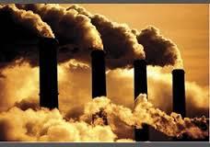

Are humans causing global warming?

Slide 12

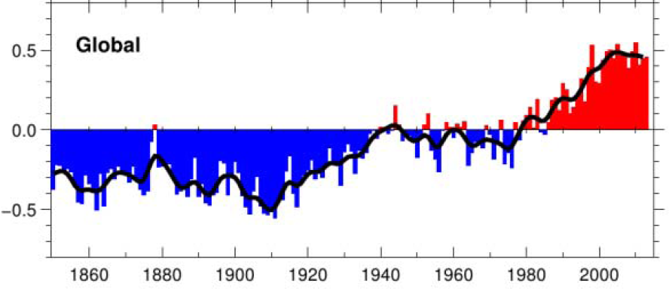
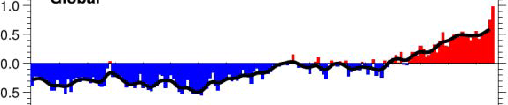
Global surface temperature anomaly
vvvvvv
http://www.cru.uea.ac.uk/cru/data/temperature/HadCRUT4.png
IPCC AR5: “It is extremely likely that more than half of the observed increase in global average surface temperature from 1951 to 2010 was caused by [humans]. The best estimate of the human induced contribution is similar to the observed warming over this period.”
Notes:
This figure shows the global surface temperature anomalies since 1850. We see a substantial temperature increase from 1910-1940, then a period of weak cooling from 1940 to the late 1970s, then a sharp increase since the late 1970’s until the 21st century when the temperatures have been relatively flat, until a recent uptick in 2014 and 2015.
So what is causing the warming? The IPCC 5th assessment report concluded:
However, the IPCC does not have a convincing explanation for the substantial warming between 1910 and 1940, and the lack of warming until 1975.

Slide 13
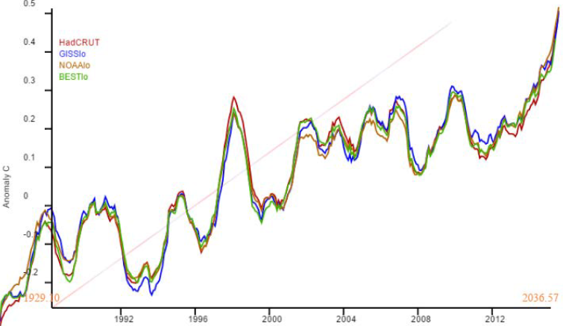
Global surface temperature anomalies
El Nino
2015 warmest year
El Nino
El Nino
El Nino
El Nino
El Nino
El Nino
Figure courtesy Nick Stokes
1992 1996 2000 2004 2008 2012
2015 was striking as ‘warmest year,’ since there
had been very little warming since 1998
Notes:
Lets take a closer look at the temperatures for the past 20 years. This figure shows 4 different global temperature data sets, and you can see that the data sets mostly agree. 2015 was striking as the ‘warmest year’, since there had been very little warming since 1998. Both 1998 and 2015 were big El Nino years, which results in warmer global temperatures owing to circulation patterns in the tropical Pacific Ocean.

Slide 14
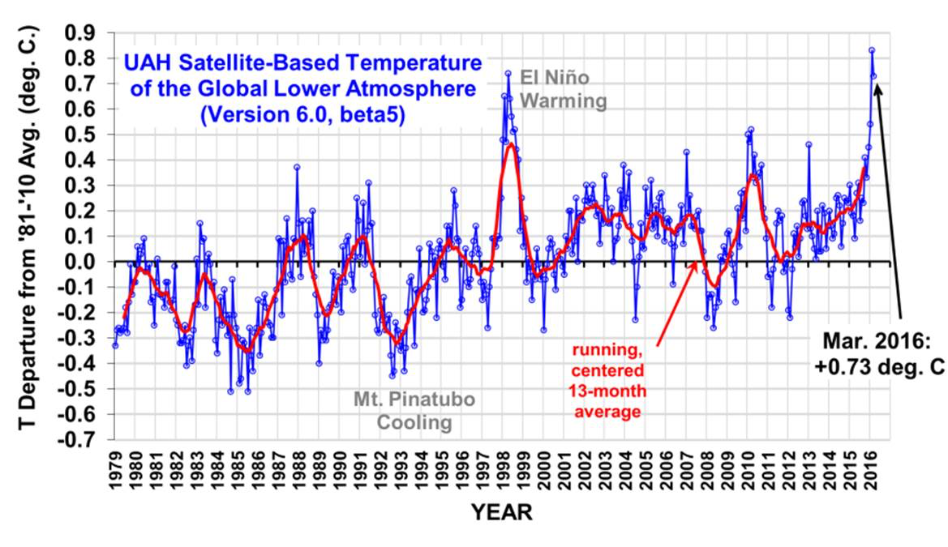
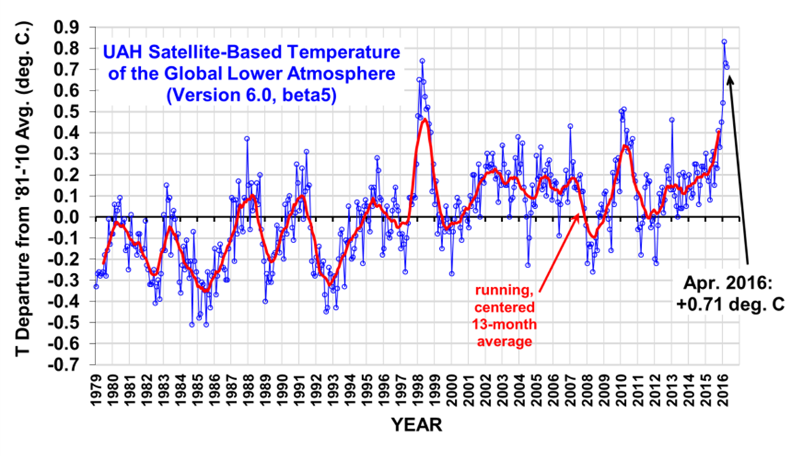
Lower atmospheric temperatures from satellite
2015
Figure courtesy of Roy Spencer
1980 1985 1990 1995 2000 2005 2010 2015
2015 was 3rd warmest year in the satellite data set,
with a large spike for Feb 2016 from El Nino
Notes:
The global surface temperature record has been criticized for the lack of global observations and the large number of adjustments that are made to the data. Satellites are able to provide truly global coverage. This figure shows the global average lower atmospheric temperatures determined from satellite. There is no warming trend in the data set since 1998, and 2015 was only the 3rd warmest year in the satellite dataset, although a spike is seen in February 2016 from El Nino.

Slide 15
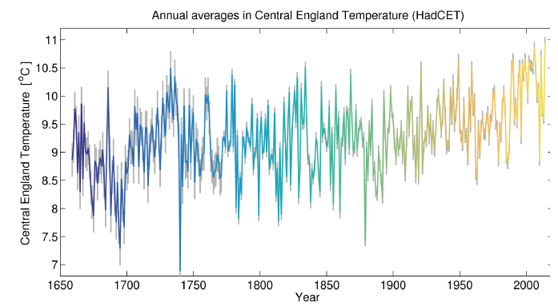
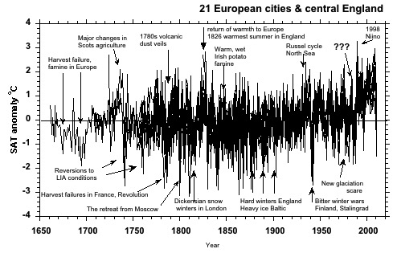
Is the warming since 1950 unusual?
http://www.climate-lab-book.ac.uk/2014/cet-2014/
Figure courtesy Alan Longhurst
Long-term warming trend: fossil fuel contribution since 1950
Year-to-year variations: volcanoes, El Nino
Multi-decadal variations: solar, ocean circulations
Notes:
So, how unusual is the late 20th century warming? There are very few historical records that go back more than 100 years. There are a number of records in Europe going back to the 17th century, including the Central England Temperature re record. Against a background of a lot of variability, you do see an overall warming trend. The large year to year variations are mostly associated with volcanic eruptions and El Nino. You also see longer term multi-decal variations, which are associated with solar cycles and long-term ocean circulation patterns. The red vertical line is a reference for the year 1950, which is CO2 began rapidly increasing, and is the reference date for the IPCC’s attribution statement on human caused climate change.

Slide 16
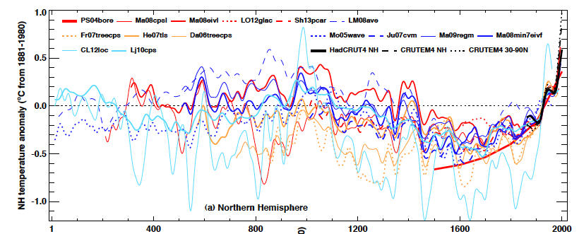
Northern Hemisphere paleoclimate
surface temperature reconstructions
IPCC AR5 2013
1 400 800 1200 1600 2000
Temperatures have been warming for the past 200-400 years;
only the warming since 1950 is being attributed to humans
Notes:
Going back further in time, we rely on paleoclimate proxies such as tree rings and ice cores to tell use about the climate. This figure is from the recent IPCC report, summarizing a number of different paleoclimate reconstructions for the past 2000 years.
The different reconstructions agree reasonably well back to 1600. We see an overall warming trend since 1600. We also see evidence of a warmer medieval period, although the uncertainty is to large to unambiguously assess whether the current warm period is warmer than the medieval warm period.

Slide 17
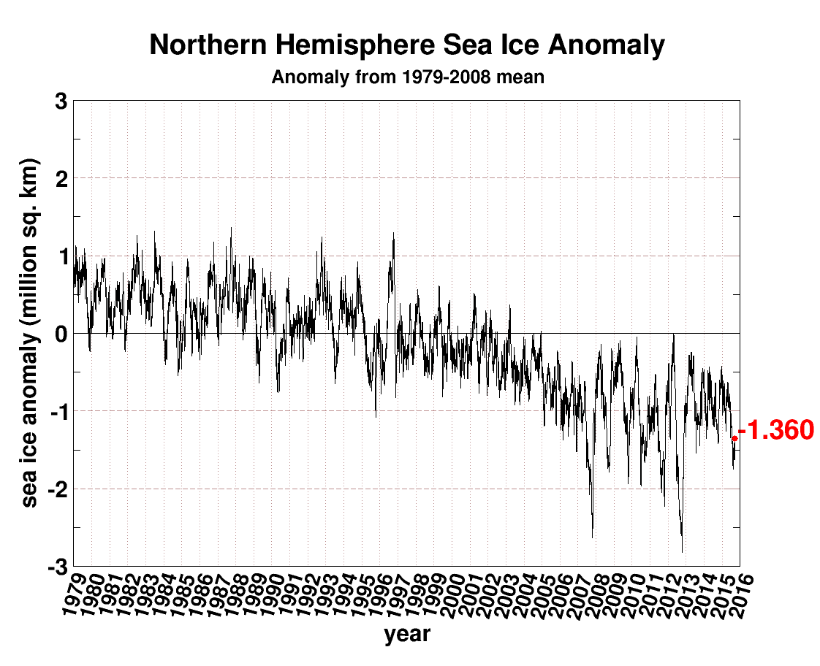
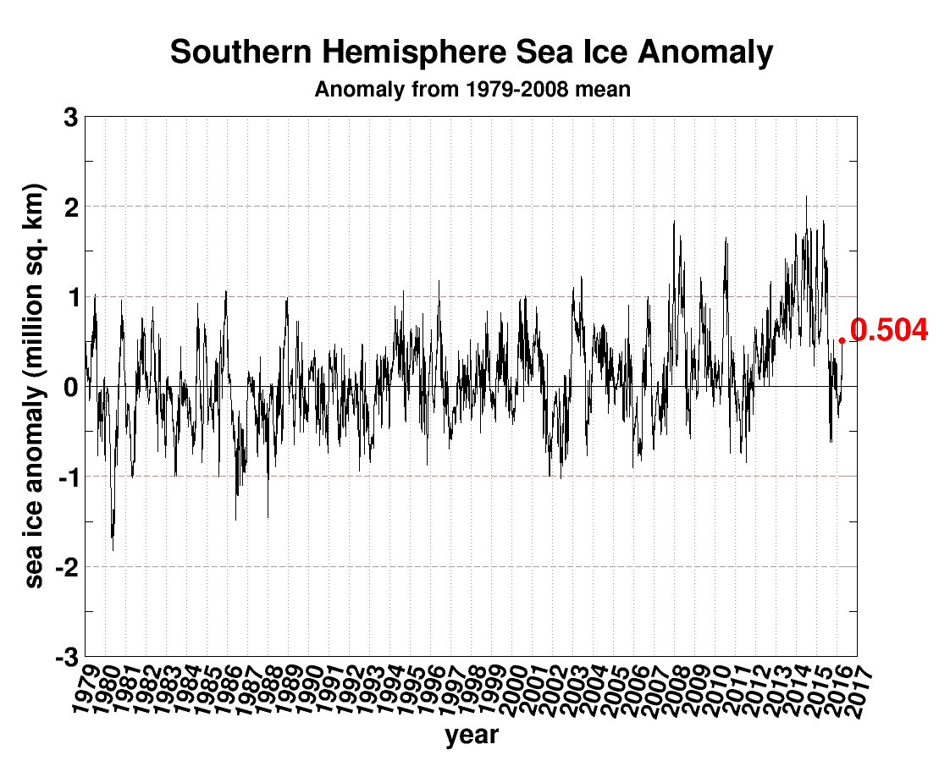
Arctic
Antarctic
http://arctic.atmos.uiuc.edu/cryosphere/
1980 1985 1990 1995 2000 2005 2010 2015
Notes:
The starkest evidence of warming is the shrinking Arctic sea ice. The top figure shows a general decline, with a precipitous drop in 2007 and a record low in 2012.
However, in the Antarctic, there is an overall trend of increasing sea ice extent. How much of the sea ice variability can be explained by human caused global warming?

Slide 18
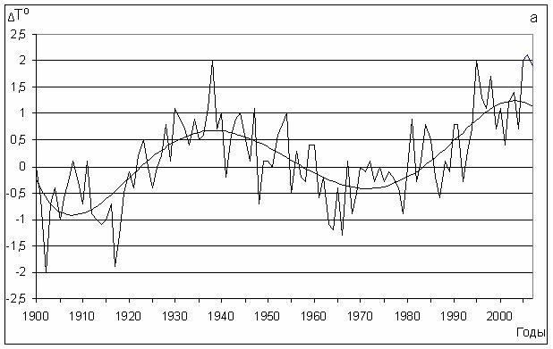
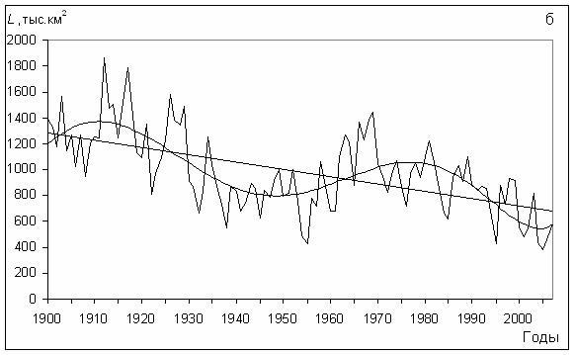
“Arctic temperature anomalies in the 1930s were apparently as large as those in the 1990s and 2000s. There is still considerable discussion of the ultimate causes of the warm anomalies in the 1920s and 1930s.” (IPCC AR5)
Surface air temperatures 70-85N
Sea ice extent (European Arctic)
Mahoney et al. 2008
Notes:
The most recent IPCC report concluded that it is likely that some of the Arctic sea ice decline. The IPCC didn’t make a more definitive statement because READ.
The figure below shows Arctic temperatures back to 1900, also sea ice extent in the Eurasian sector. You can see that temperatures in the 1930’s were nearly as warm as the recent temperatures, which was followed by low sea ice extent in the 1940’s and 1950’s. Unfortunately, we don’t have good sea ice data in the American sector going back much before 1950.

Slide 19

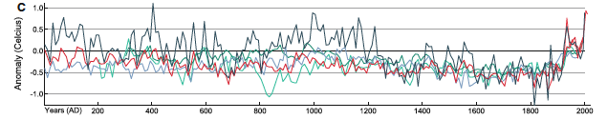
IPCC AR5: “A recent multi-proxy 2000-year Arctic temperature reconstruction shows that temperatures during the first centuries were comparable or even higher than during the 20th century.”
Hannhijarvi et al. 2013
200 400 600 800 1000 1200 1400 1600 1800 2000
Notes:
This figure gives a longer term perspective on Arctic climate variability, we don’t have confidence in explaining what caused the warming since 1975. The top curve in black is the latest paleoclimate reconstruction of Arctic temperature. You see substantial variability, with warm temperatures particularly in the first 6 centuries.

Slide 20
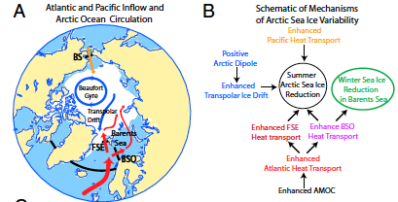
Mechanisms of Arctic sea ice variability
xxx
Zhang 2015
Notes:
So what is causing all the variability in the Arctic climate and sea ice? Heat transport from the Atlantic and Pacific play a big role. Also atmospheric circulation patterns can result in an export of sea ice into the Atlantic Ocean – this is what happened for a few years before the big sea ice decrease in 2007. So natural variability has been playing a big role in what has been going on with the Arctic sea ice for the past two decades. I agree with the IPCC, that it is likely that there is some influence from humans. But at this point, I regard the importance of human caused warming as very uncertain, when considered against the background of natural variability.

Slide 21
Composition
Notes:
So, what causes the Earth’s climate to vary? On very long time scales, we have changes to the Earth-Sun geometry, continental drift and mountain building. On decadal to century time scales, we changes in solar output, large scale ocean circulation, and changes in surface reflectivity mainly caused by changes in snow and ice. And on shorter time scales, we have volcanic eruptions and changes in clouds. Changes in atmospheric composition, including addition of CO2 and other greenhouse gases and also pollution aerosol, are but one factor in causing climate variability.

Slide 22
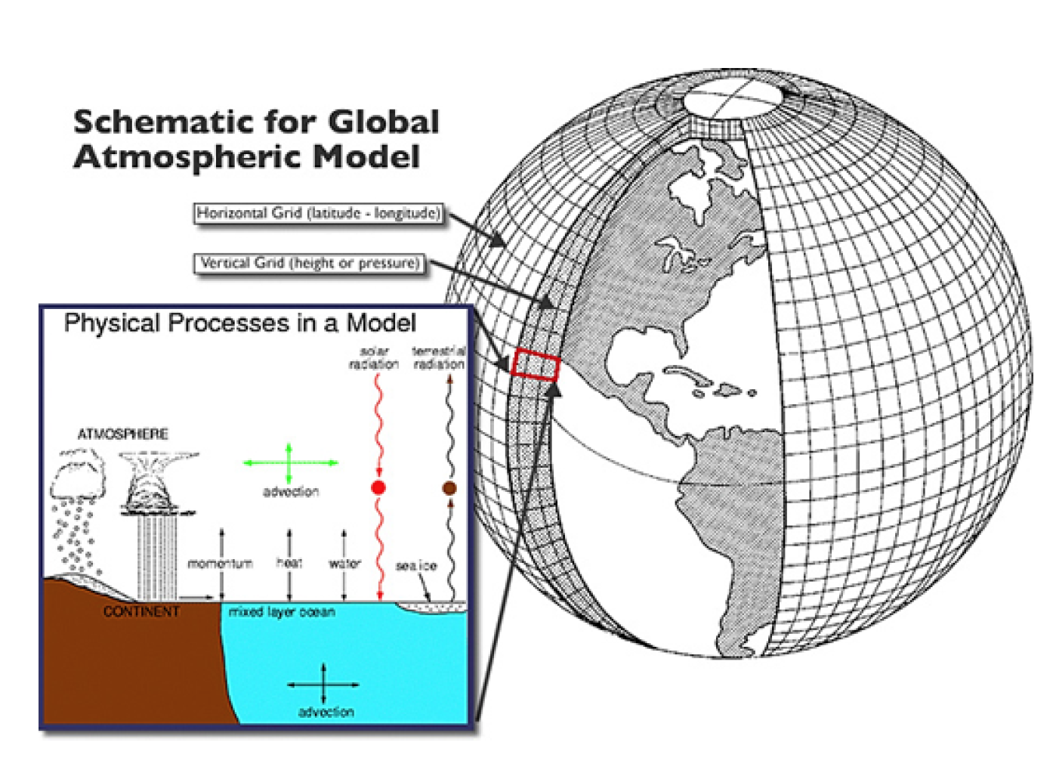
Climate Models
Climate models represent the atmosphere, land surface, the ocean and the cryosphere on thousands of gridpoints in the atmosphere and the ocean. The model framework is based on the laws
of physics
Grid points in the atmosphere of the best models are ~ 100 km apart
23 different models were used by the IPCC in their assessment
Notes:
You can’t sort out natural from human caused climate change simply by looking at the observational data. Global climate models are used to help understand the Earth’s climate system. READ.
One of the biggest challenges in climate models is that many of the important processes, such as clouds and rainfall, occur on spatial scales that are much smaller than the resolution of the model. Hence these processes need to be parameterized, which introduces a host of tuning knobs into the models
However, the greatest uncertainties arguably come from processes that are not even included in the models.

Slide 23
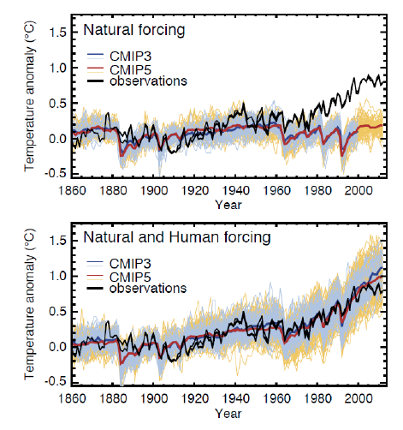
Solar + volcanoes +
natural aerosol
What has caused
the warming?
Warming since 1950:
Human forcing
Warming 1910-1940:
Models produce slight
warming due to reduced
volcanic activity and small human effects
Cooling 1940-1975:
Not reproduced by the
models
Natural + greenhouse
gases + pollution aerosol
IPCC AR5 Chapter 10
Notes:
Climate models are used to infer the relative importance of human forcing to natural variability. The top figure compares climate model simulations using natural forcing (the red curve), from the sun and volcanoes, with observations the black curve. This bottom figure compares climate model simulations using both natural and human forcing with the observations. You can see that simulations with human forcing are much closer to observations after 1970. This kind of analysis provides the basis for the IPCC conclusion that the warming since 1950 is caused by humans. However, the climate models don’t reproduce the substantial warming from 1910-1940, and the cooling from 1940-1975. Not also the divergence of the model and observations in the most recent decade.

Slide 24
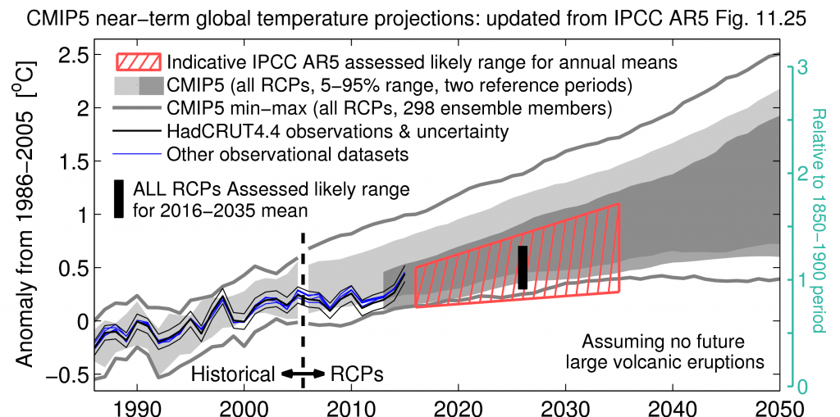
Growing divergence: climate models vs surface temperature observations
Figure courtesy of Ed Hawkins
Notes:
Lets take a closer look at this comparison for the last few decades. The black and blue lines are the surface observations, and the gray plume is the ensemble of climate model simulations. You can see that following the spike from the large El Nino in 1998, the observations are at the bottom of the envelope of climate model simulations, until 2015 which was another large El Nino, and the temperatures barely made it to the middle of the pack of the climate model simulations. Overall, the recent warming is significantly slower than expected by the climate model simulations. In fact the hashed red area reflects the IPCC’s projection out to 2035, which was lowered relative to the climate model projections, because of this discrepancy.

Slide 25
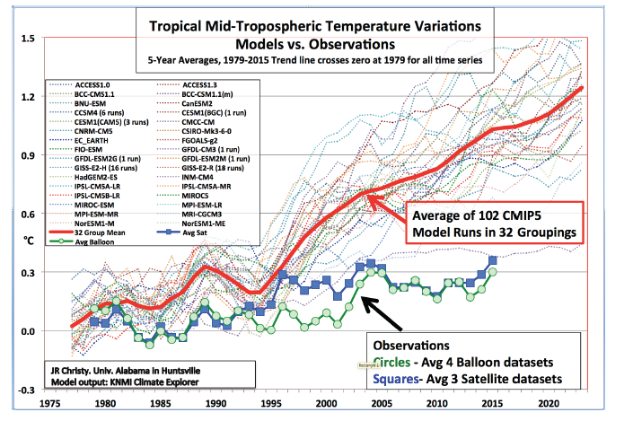
Growing divergence: climate models vs
tropical mid-troposphere observations
1975 1980 1985 1990 1995 2000 2005 2010 2015 2020
Figure courtesy John Christy
Are climate models too sensitive to greenhouse forcing?
Is modeled natural climate variability inadequate?
Are model projections of 21st century warming too high?
Notes:
Climate models predict the largest amount of warming to occur in the upper atmosphere over the tropics, associated with the deep convection. However, observations of the tropical mid-tropospheric temperatures, both from satellites and weather balloons, show very little warming. In fact, the climate models predict three times more warming than what has been observed.
This growing divergence between models & observations raises some serious questions:

Slide 26
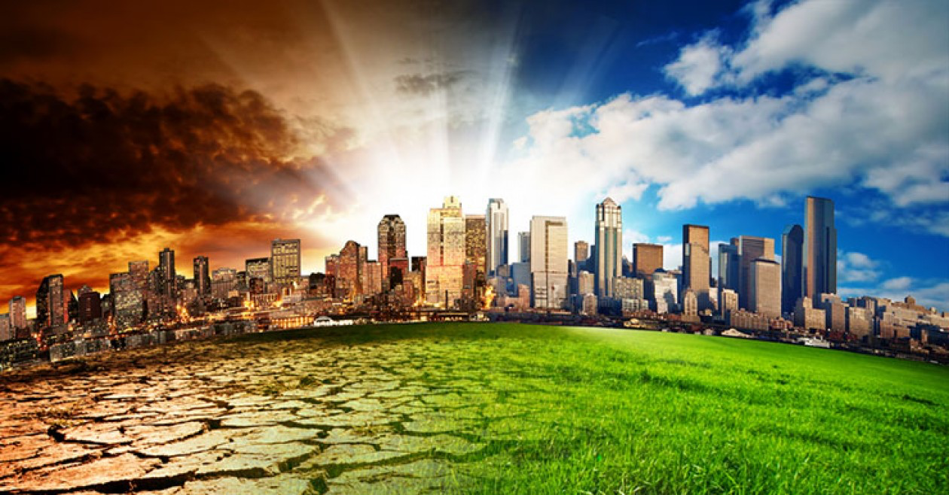
Whither the climate of the 21st century?
georgecartercongdon.com
Notes:
The key issue of policy relevance is what is going to happen to the climate of the 21st century.

Slide 27
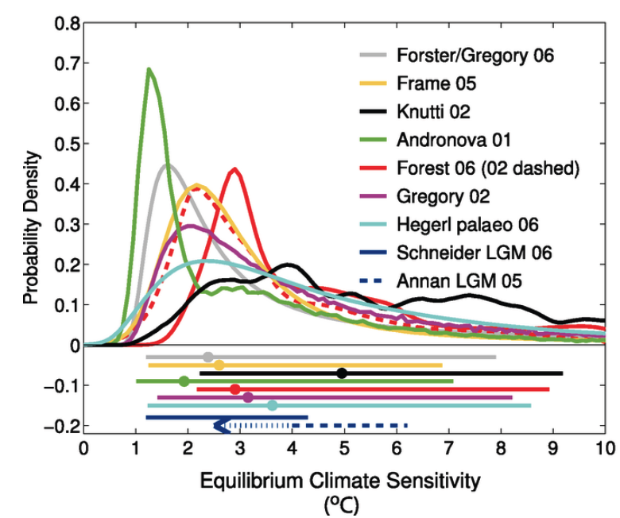
Equilibrium Climate Sensitivity
Definition: Global surface temperature change following a doubling of atmospheric CO₂ concentration
Determined from:
• global climate models
• historical observations
• paleoclimate reconstructions
Notes:
A key

Slide 28
Equilibrium Climate Sensitivity (ºC)
Median 5th pctile 95th pctile
IPCC AR4 (2007) 3.0 1.5 -
IPCC AR5 (2013) - 1.0 6.0
Climate models 3.2 2.1 4.7
Observations 1.7 1.1 4.4
Observations* 1.5 1.1 2.4
*incorporates lower aerosol forcing
Costs of warming are dominated by the extreme tail values

Slide 29
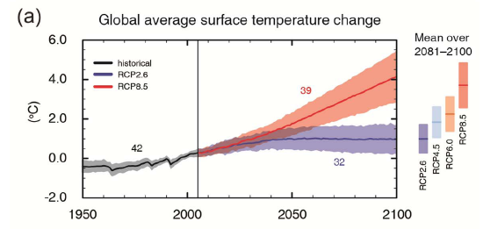
Implications for the future:
I. IPCC AR5 view
AR5 2013
The amount of warming depends on the
emission of greenhouse gases

Slide 30

You find what you shine a light on . . .
Unknown unknowns
Solar effects
Long-term ocean
oscillations
Volcanoes
Greenhouse gases
Underwater volcanoes
Land use
Solar system gravitational
& magnetic interactions
Aerosols
Notes:
Here is the problem that I have with the climate model projections and climate science in general. Have you heard the story about the drunk searching for his lost keys under a street light, since that is the only place where he can see anything? Well something similar has been happening with climate science. You find what you shine a light on. Motivated by the UNFCCC and IPCC and government funding, climate scientists have focused primarily on human caused climate change. Other factors important for understanding climate variability have been relatively neglected, I have highlighted long-term ocean oscillations and solar indirect effects, since I think that these are potentially very important on decadal to century timescales.

Slide 31
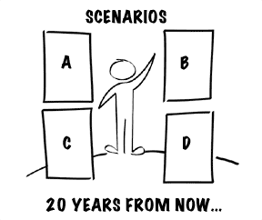
Scenarios of future climate
CO2 emissions
Long range
ocean oscillations
Solar effects
Geologic
processes
Volcanic
eruptions
Unknowns
50 YEARS, 100 YEARS

Slide 32

Implications for the future:
II. View emphasizing natural variability
The slowdown in warming since 1998 will continue at least another decade (into the 2030’s?)
Climate models are too sensitive to human forcing; 21st century warming will be on the low end of IPCC projections (or even below)
Solar variations & volcanoes: wild card. Some are predicting solar cooling in the near term
Can’t rule out unforeseen surprises
Notes:
The other perspective emphasizes natural variability READ

Slide 33
Why do scientists disagree?
Insufficient & inadequate observational evidence
Disagreement about the value of different classes of evidence (e.g. global climate models)
Disagreement about the appropriate logical framework for linking and assessing the evidence
Assessments of areas of ambiguity & ignorance
Belief polarization as a result of politicization of the science
Uncertainty • Doubt • Ignorance
Notes:
A majority of climate scientists seem to support the IPCC perspective, with recent surveys of scientists suggesting 52-85% of climate scientists agree with the IPCC. READ None of the most consequential scientific uncertainties are going to be resolved any time soon; there is a great deal of work still to do to understand climate change.

Slide 34
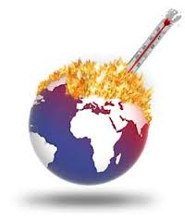
Is global warming dangerous?
The UNFCCC has defined ‘dangerous’ as 2ºC post industrial
warming; we have already warmed more than 0.9ºC
When we will reach 2ºC depends not
only on ECS, but also on natural
climate variability
Efforts to redefine ‘dangerous’ as
1.5ºC post industrial warming
are underway
Notes:
Apart from the issue of how much warming we can expect to see in the 21st century, the critical issue for public policy is whether global warming is dangerous.
READ
The dangers that are most widely discussed in the context of climate change are sea level rise and extreme weather events.

Slide 35
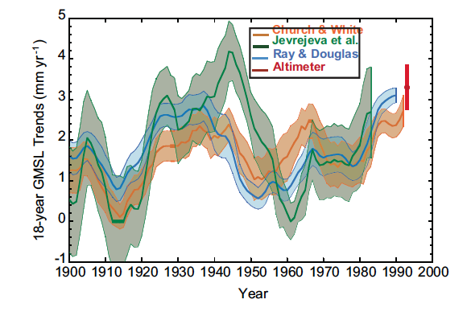
Is the IPCC’s sea level rise conclusion justified?
IPCC AR5
IPCC AR5: “Since the early 1970’s, glacier mass loss and
Ocean thermal expansion from warming together explain about
75% of the observed global sea level rise (high confidence)”
Notes:
Let’s first take a look at sea level rise. The IPCC 5th Assessment Report concluded READ.
I really don’t understand how they can make this statement with high confidence. Global sea level has been rising for thousands of years, since the last ice age. The key question is whether human caused warming is accelerating the sea level rise, beyond the natural rate. This figure shows the time series of 18 year average sea level trends. The read line represents sea level rise determined from satellite altimeter data, which has been available since 1993, you see a value of 3.2 mm/yr. The more recent rate of sea level rise, from 2003-2011 is 2.4 mm/yr. If you look back to the 1930’s and 1940’s, the rate of sea level rise was at least as large as the recent values when there was little contribution from human caused warming.

Slide 36
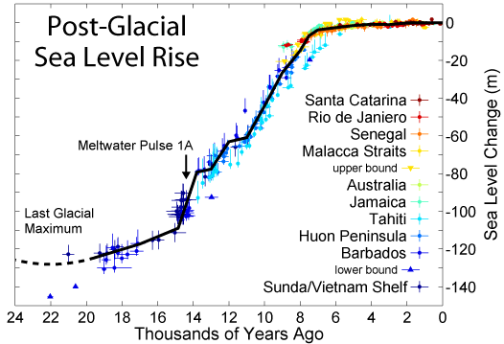
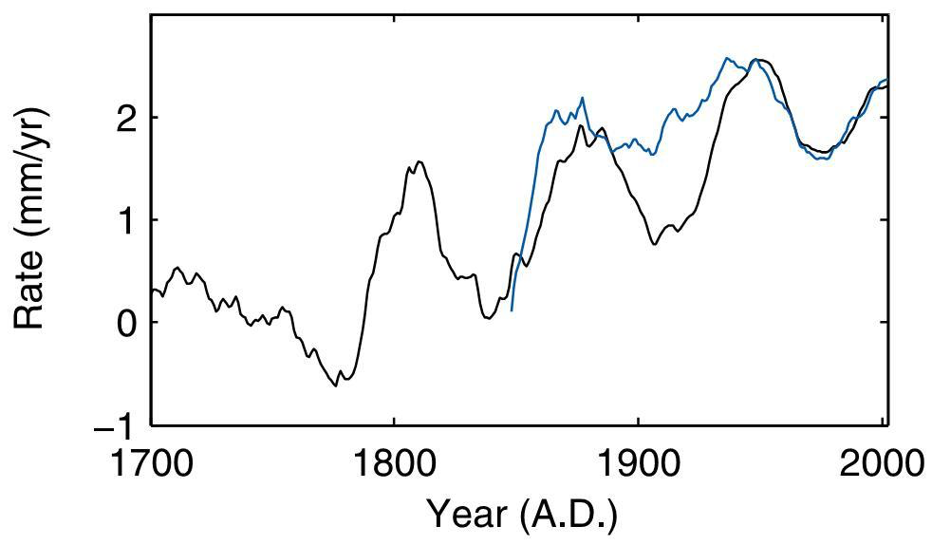
Sea level has been rising
since the end of the
last ice age
Debate: did recent
sea level rise
acceleration begin
over 200 years ago?
Jevrejeva et al. 2008
Notes:
Sea level has been rising since the end of the last ice age. About 8000 years ago, the rate of sea level rise slowed down. Tidal measurements are available back to the 1700s. A key topic of debate is whether the recent sea level rise began over 200 years ago, and whether the current rate of sea level rise is unusual.

Slide 37
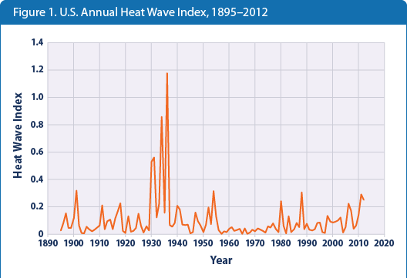
US Annual Heat Wave Index, 1895-2012
Source: EPA
“It is likely that the frequency of heat waves has increased in large parts of Europe, Asia and Australia.” (since 1950) IPCC AR5
Notes:
Lets take a look at heat waves. This figure, from the EPA, plots theUS annual heat wave index, related to the extent and duration of heat waves. You see an overwhelming spike in the 1930’s, and the most recent decade doesn’t stand out at all. The dust bowl era of the 1930’s stands out starkly in terms of record heat waves and droughts, which were far more extreme than anything in recent decades that can be attributed to human caused climate change.

Slide 38
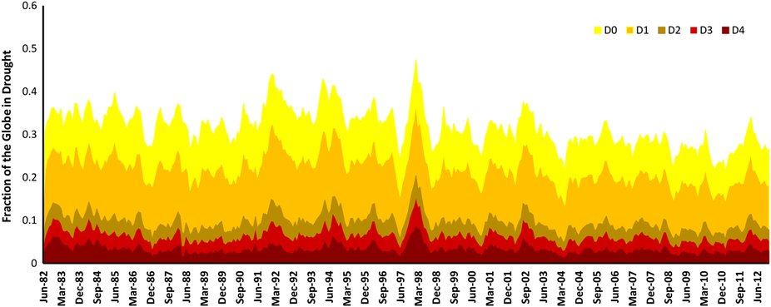
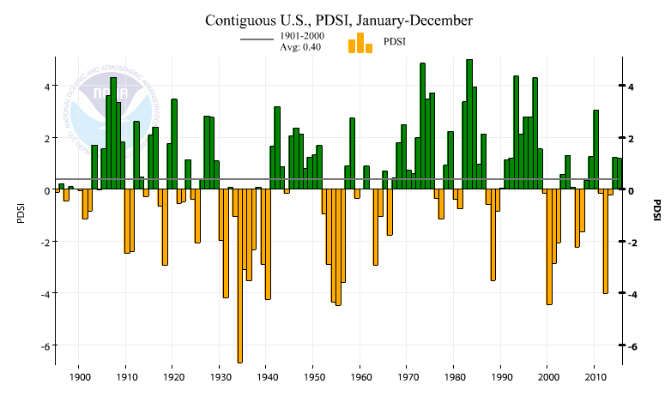
Fraction of global drought since 1982
Hou et al. 2014
Contiguous US drought (PDSI) 1895 - 2015

Slide 39
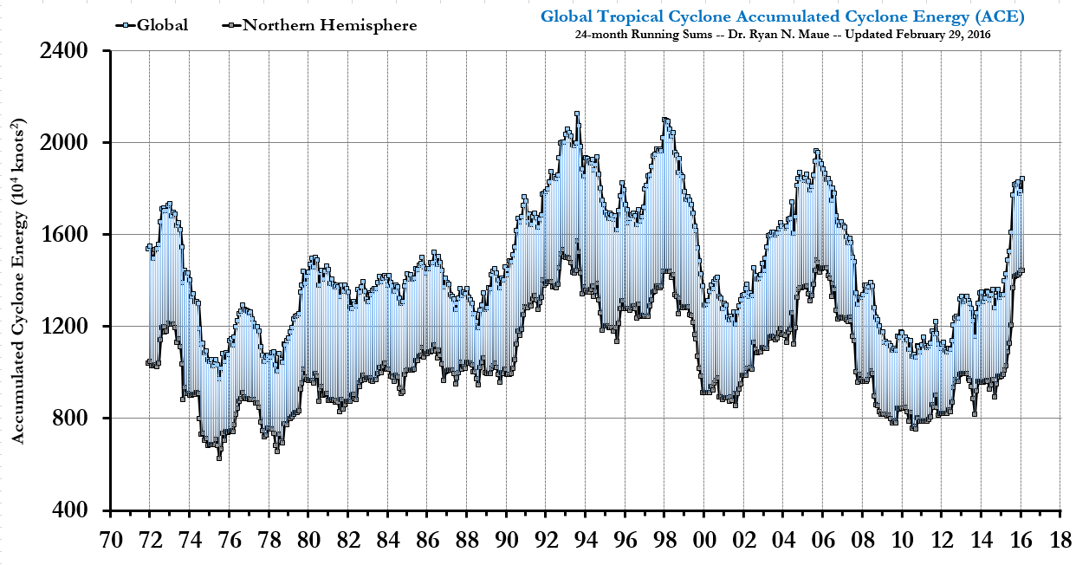
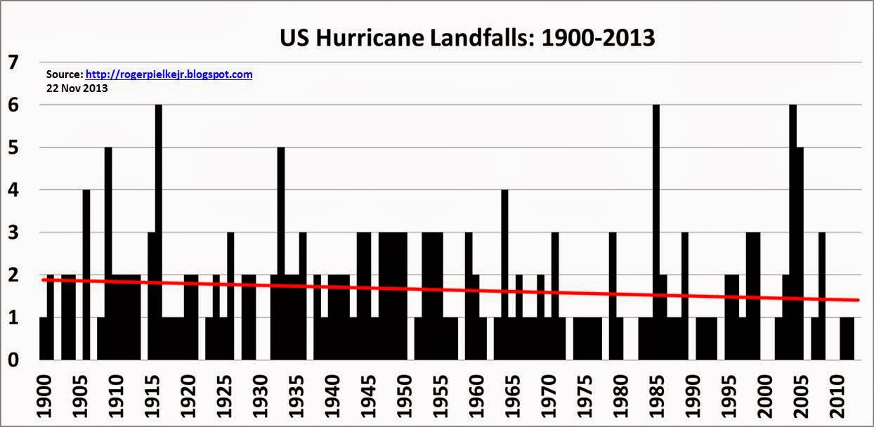
Are hurricanes made worse by climate change?
Source: Ryan Maue
Global tropical cyclone ACE
US landfalling hurricanes
Source: Roger Pielke Jr
Notes:
Lets take a look at the hurricane data.
The punch line is this. Any impact of human caused global warming is lost in the noise of natural climate variability.

Slide 40
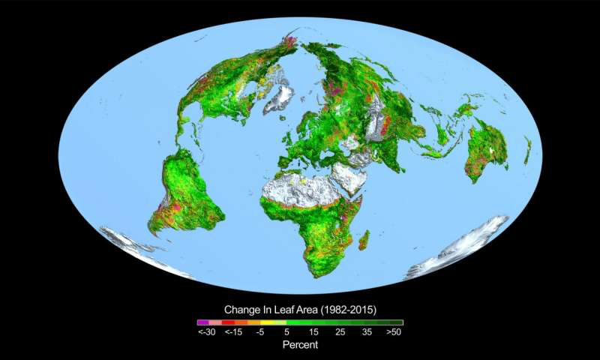
Rise in CO₂ greening Earth since 1982
Zhu et al. 2016
Greening over 25-50% of global vegetated area; 4% browning
CO₂ fertilization effects explain 70% of the greening trend
Notes:
And finally, we have to ask whether there are benefits from increased CO2. A new paper was published last month that analyzed vegetation from satellite. The study found greening, or an increase in vegetation over 25-50% of the area, with only 4% of the area showing browning. They attributed 70% of the greening trend to CO2 fertilization.

Slide 41

How should we respond to climate change?
There is increasing evidence that the threat from global warming is overstated
However, if the threat is not overstated, there are major shortfalls in current and proposed solutions.
Notes:
So how should we respond to the threat of climate change, given the uncertainties? On the one hand, READ

Slide 42
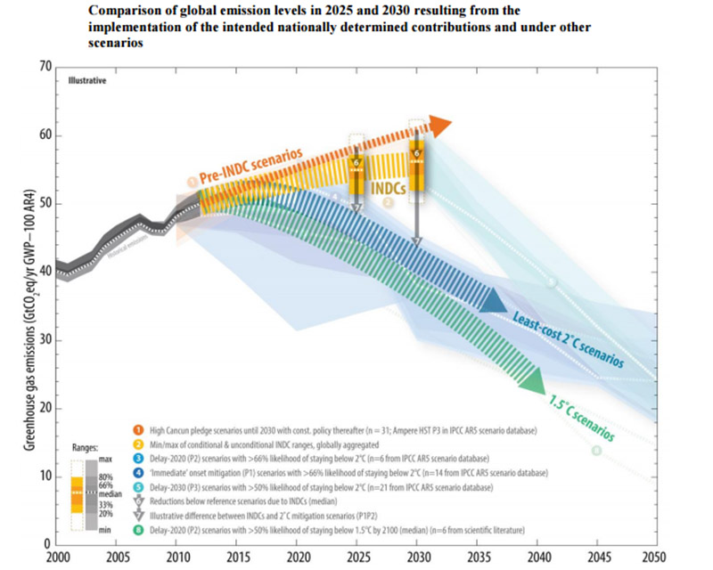
Notes:
I would like to start by noting the inadequacy of the Paris agreement. This figure was recently provided by the UN, which plots greenhouse gas emissions out to 2050. The top orange curve is the current emissions trajectory. The yellow curve represents the new trajectory from the Nationally Determined Contributions out to 2030, which barely makes a dent in the emissions. If you believe the climate models, the blue curve represents the trajectory we need to be on to limit warming to 2C, and the green curve is the trajecting for limiting the warming to 1.5C.

Slide 43

How much warming will emissions reductions
commitments to 2025-2030 (sustained)
prevent in the 21st century?
U.S.: (ECS = 3ºC)
The U.S. NDC of 28% reduction of emissions below 2005 levels by 2025 will prevent 0.03ºC in warming by 2100
Global estimates
• 0.17 - 0.2ºC is optimistic target
• India’s NDC will double - triple
emissions by 2030
EXERCISE IN
FUTILITY ?
Lomborg, 2015

Slide 44
Can we limit the warming to 2ºC?
Yes, if the climate sensitivity is at lower end of estimates (emissions reductions will make little difference)
No, if natural climate variability is dominating the warming
(emissions reductions will make little difference)
If the IPCC climate model projections are correct: even dramatic reductions in CO₂ emissions by 2050 would have small impact on temperatures in the 21st century
(Some) economists: Missing the 2°C target will not lead to a large welfare loss.
Notes:
For the sake of argument, assume that 2C of warming is dangerous. READ

Slide 45
Concerns about the Paris Agreement
In-country legal, political & economic issues – nonbinding agreement and voluntary compliance by developing countries ensures that emissions will continue to rise
Technical feasibility: no known technologies that are feasible, economic, scalable & politically acceptable to substantially reduce CO₂ emissions from power, transportation, agriculture, cement on the timescale of a few decades
Confounding factors:
Global population increase
Bringing grid electricity to undeveloped countries
Rapid economic development in developing and undeveloped countries

Slide 46


Tame Problem
President Obama: “We don’t have time
for a meeting of the Flat Earth Society”
versus
JC: The climate change
problem and its solution
have been vastly
oversimplified.
Mess
Wicked Mess
Wicked Problem
Notes:
So, how did we come to the point where we have international agreement on a very costly climate plan that will do little to change the climate? President Obama said in his state of the Union Address: “We don’t have time for a meeting of the Flat Earth Society.” This statement reflects a view climate change as a ‘tame problem’, where we have clearly understand the problem and have identified the appropriate solutions.
I view the climate change problem very differently, as a ‘wicked mess’. A wicked problem is complex with dimensions that are difficult to define and changing with time. A mess is characterized by the complexity of interrelated issues, with suboptimal solutions that create additional problems. My concern is that the climate change problem and its solution have been vastly oversimplified

Slide 47
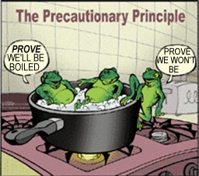
The Precautionary Principle
"Where there are threats of serious or irreversible damage, lack of full scientific certainty shall not be used as a reason for postponing cost-effective measures to prevent environmental degradation."
Based upon the precautionary principle, the UNFCCC established a goal of stabilization of atmospheric greenhouse gases to prevent
dangerous climate change
Stabilization targets are set at the lowest critical threshold value
Notes:
In the ‘tame problem’ approach, the adopted framework for tackling climate change is the Precautionary Principle. The precautionary principle was articulated by the UN back in the 1990’s as follows. READ

Slide 48

Precautionary Principle: ‘Wrong Trousers’
A mismatch between problem and solution: For a wicked problem, the precautionary principle is an oversimplification that can lead to overreactions that cause more harm than benefits and introduce new systemic risks. (Prins and Rayner)
Current thinking focuses on risk management (e.g. cost/benefit) rather than the precautionary principle. However, UNFCCC policies are still framed by the precautionary principle.
Notes:
The precautionary principle is a very poor fit for addressing a wicked problem. Prins and Rayner used the phrase ‘wrong trousers’, playing off wallace & Gromits. Prince and Rayner argued that there is a . . . READ

Slide 49
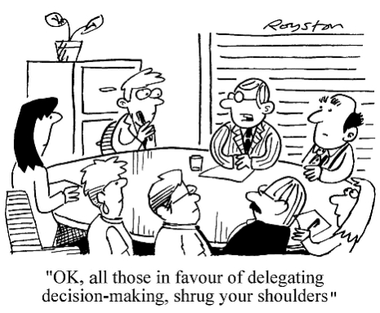
Options for decision makers confronted
with deep uncertainty and wicked messes:
Do nothing
Enlarge the knowledge base for decisions
Adaptive management
Build a resilient society

Slide 50
Conflict of values
Survival
Outlast
Better than
dead
Try for personal
survival: group
or nation
Meet basic
Needs
Sustainable
Maintain
Endure in a
stable world
Able to maintain
at a given rate,
level over time
Mitigate damage
Sacrifice, austerity
Obligations
Resilience
Bounce back
Recover quickly
from difficult
conditions
Survive longer in
changing world
Adaptation,
redundancy
Thrivability
Bounce forward
Prosper, thrive,
develop
vigorously
Strive for
greatness
Anti-fragile,
generate,
transform
Notes:
One of the reasons that the climate change problem is a wicked mess relates to a massive conflict of values. Sustainability is the value that is driving the UN climate policies that are trying to mitigate damage by reducing CO2 emissions. These policies are in stark conflict with survivability issues in the developing world, where there are severe challenges to meeting basic needs and where their idea of clean green energy is something other than burning dung inside their dwelling for cooking and heating. While the UN policies also include adaptation, which is targeted at increasing reslience, funds for mitigation are in direct competition with funds for adaptation. And finally we have thrivability, which is about people wanting not only to make money and support economic development, but also to strive for greatness and transform the infrastructure for society. The goals of thrivability are also in conflict with sustainability, with its emphasis on austerity and obligations and its costs that conflict with economic development goals.

Slide 51
Robust strategies (multiple benefits with little downside):
Water resource management
Infrastructure security
Agricultural productivity
Ecological conservation and restoration
Resource conservation & reuse
Energy research
sustainable
robust
resilient
Notes:
Thinking about the problems in new ways, and trying to accommodate different values, can lead to solutions that have greater political viability. For example, at the intersection of sustainability and resilience, you can identify robust strategies that have multiple benefits with little downside.

Slide 52
Antifragility learn and grow from volatility and unexpected events:
Economic development
Reduce the downside from volatility
Optionality
Small experiments; tinker
Transformative ideas
survivability
anti-fragility
thrivability
Notes:
The challenges of climate change related to survivability can benefit from thrivability thinking, particularly some strategies suggested by anti-fragility strategies, whereby you learn and grow from adversity. Some of these strategies include economic development, reducing the downside from volatility, developing a range of options, tinkering with small experiments, and developing and testing transformative ideas.

Slide 53
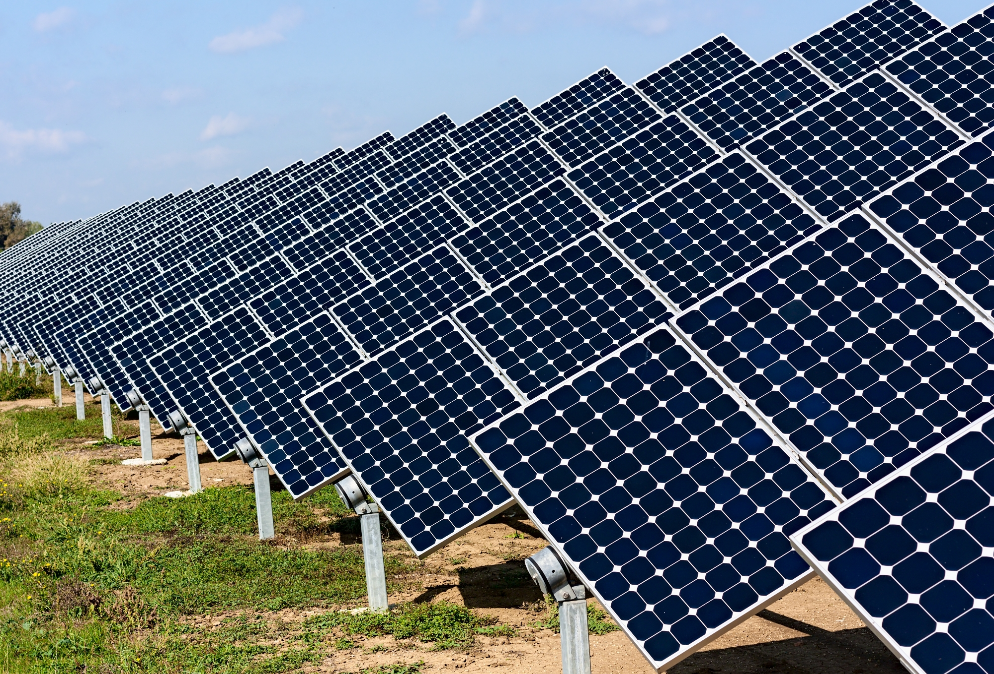
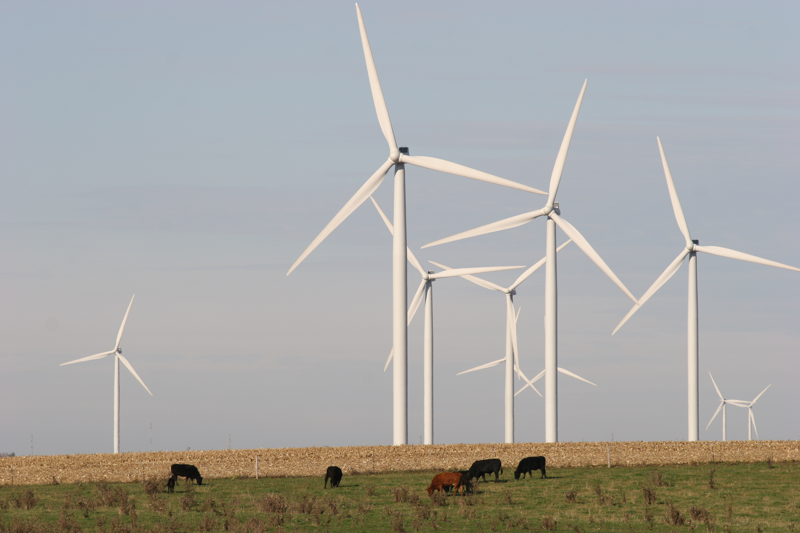
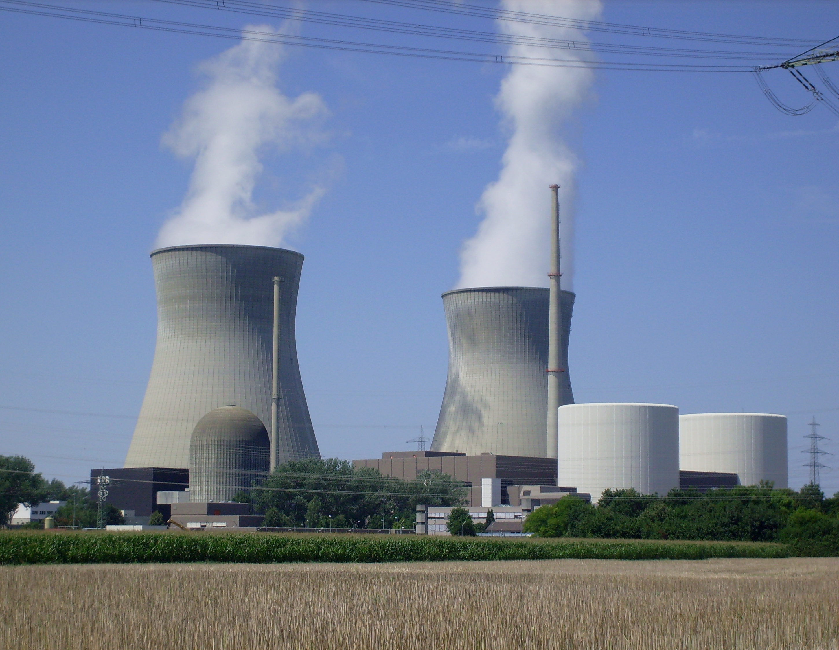
Challenges for the energy sector
Provide reliable power economically:
Growing demand
Need for rapid 3rd world development
Aging infrastructure
Desire/demand for clean, green energy
Uncertain and changing federal climate policy
Notes:
In the midst of all this, there are obviously substantial challenge for the energy sector. The key challenge is to provide reliable power economically, in the face of:

Slide 54

Weather & Climate Prediction for the Energy Sector
  Tactical adaptation:
  Probabilistic prediction of high impact extreme events on daily to seasonal time scales
  Support energy trading, economic development, risk management, disaster mitigation, regional stability, long-range asset planning
www.cfanclimate.net
Notes:
We don’t know how the climate of the 21st century will play out. But there is some significant skill in predicting weather and climate on daily to seasonal time scales. My company, Climate Forecast Applications Network, is developing strategies using probabilistic weather and climate forecasts to predict high impact extreme events in support of tactical adaptations for the energy sector. Our forecasts are being used to support energy trading, READ

Slide 55
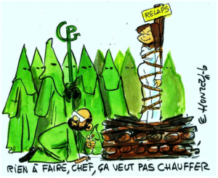
We have oversimplified both the problem and its solution
Wicked mess
Notes:
In summary I hope I have provoked you into thinking about the climate problem as a very complex one, that can be characterized as a wicked mess. My main take home message for you is that we have oversimplified both the problem and its solutions.
My views on all this are not popular among many of my academic colleagues in the climate community, although they are gaining some traction in the broader academic community. This cartoon was drawn for me by a french cartoonist following a Scientific American article on me that was titled Climate Heretic Judith Curry. The caption says “Sorry boss she won’t burn”
So I’m continuing my odyssey to wrap my head around the climate change problem, and to provoke thinking outside the box about both the science and policy options.

Slide 56

http://judithcurry.com
Climate Etc. provides a forum for technical experts and the interested public to engage in a discussion on topics related to climate science, its impacts and policy options.
twitter: @curryja

